Slide 1

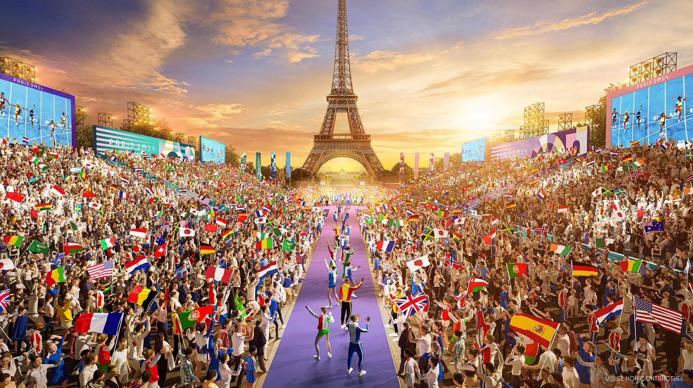
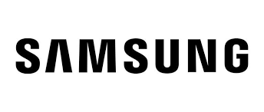
Samsung X Paris Olympics 2024
Driving Marketing Performance Fall 2024 MBA- 806
Presented to – Leigh Klein
Presented By Team 5
Leon Luo
Shreya Bharat Parmar
Chintan Samirbhai Jikkar
Fnu Bhavya
Radhika Kaw

Slide 2
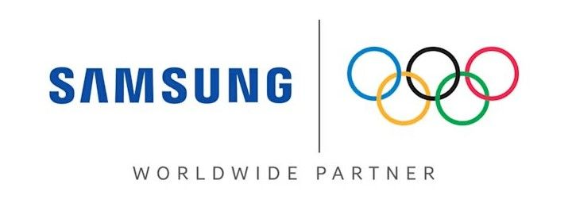
Overview of Samsung's Olympic Marketing
1
2
3
Sponsorship
Message
Medium
Samsung continues its long-standing partnership with the Olympics, reinforcing brand prestige.
"Open always wins" emphasizes Samsung's commitment to innovation and inclusivity.
Multi-channel approach includes video ads, social media campaigns, and interactive experiences.

Slide 3
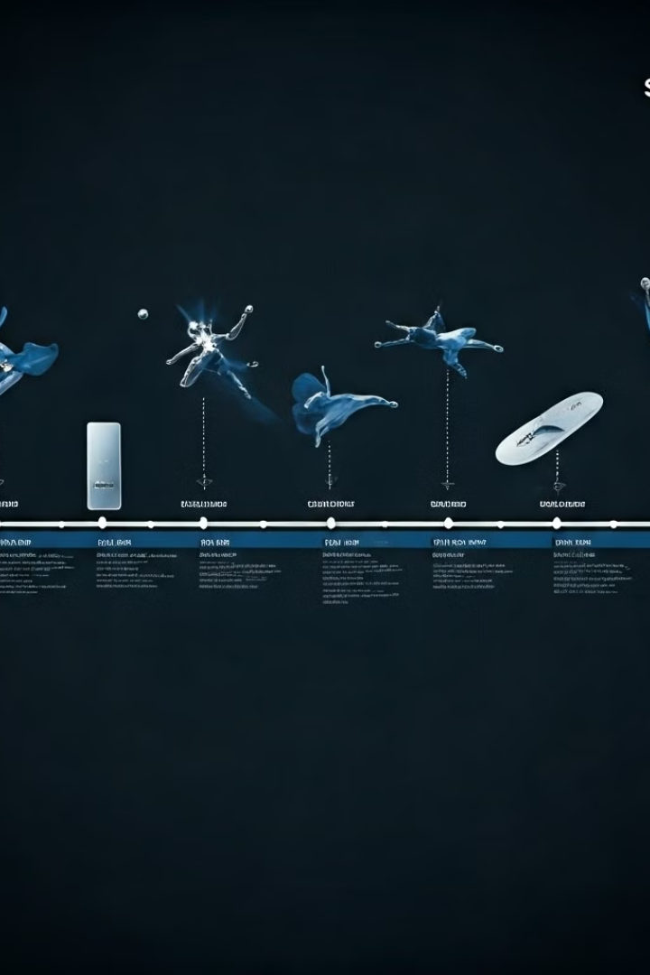
A Brief History of Samsung's Olympic Sponsorship
1
1998 - 2002
Samsung became an International Olympic Committee (IOC) TOP sponsor, marking the beginning of its long-standing partnership with the Olympic movement.
2
2006 - 2016
Samsung expanded its sponsorship to include the Paralympic Games, further strengthening its commitment to inclusivity and accessibility.
3
2017 - Present
Samsung continues to innovate its marketing strategies, leveraging new technologies and platforms to engage with Olympic fans globally.

Slide 4
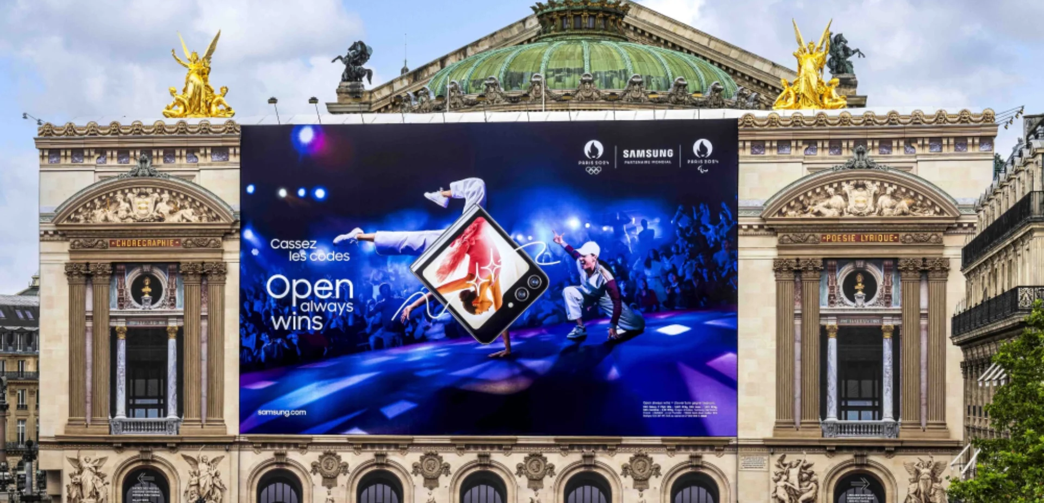
“OPEN ALWAYS WINS”

Slide 5
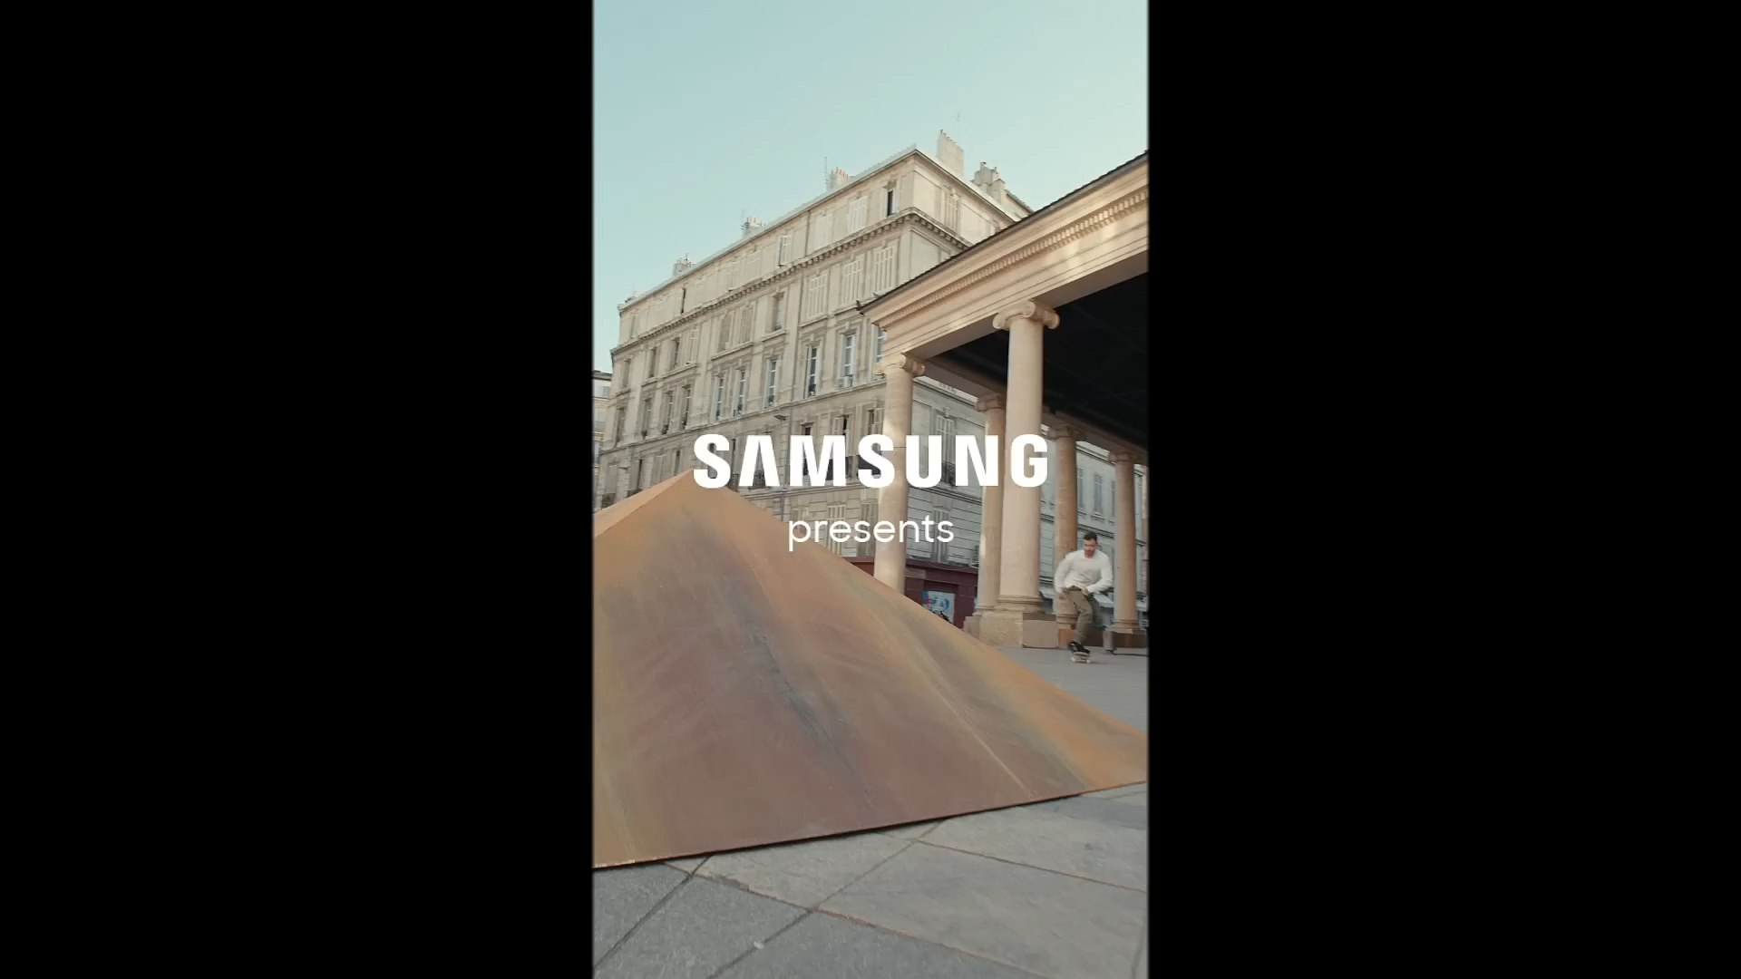

Slide 6
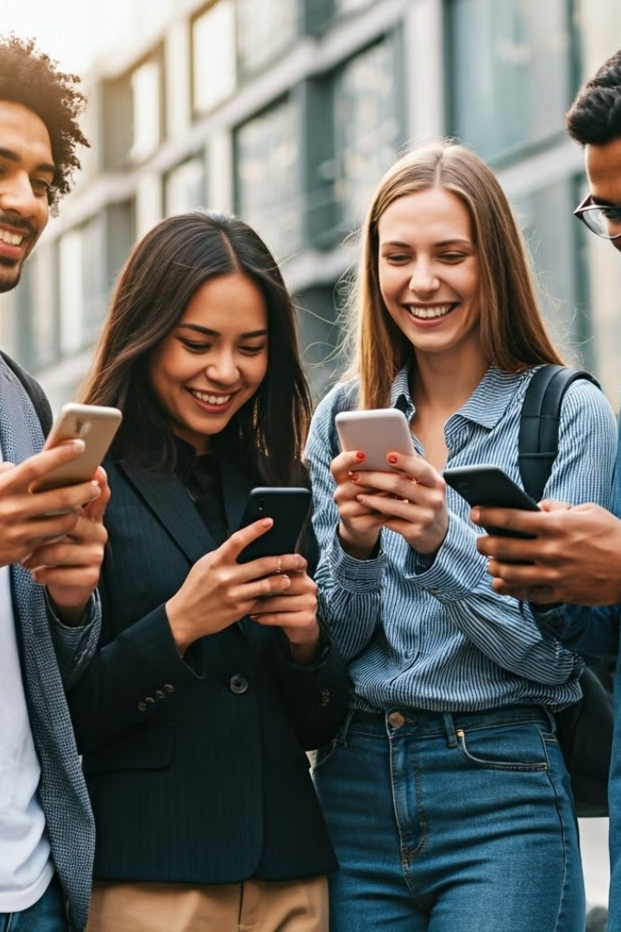
Target Audience Overview
1
Age Range
Samsung targets tech-savvy individuals aged 18-45, focusing on millennials and Gen Z.
2
Income Level
Middle to upper-middle class, as Samsung products range from mid-tier to premium prices, with newer technology products appealing to those who can afford to invest in cutting-edge devices
3
Gender
Likely targeted at both males and females, as Samsung's products (particularly smartphones, wearables, and electronics) appeal broadly across genders.
4
Occupation
The campaign may appeal to a variety of occupations but particularly those involved in creative, tech-savvy, and active lifestyle fields, such as professionals, students, and athletes

Slide 7
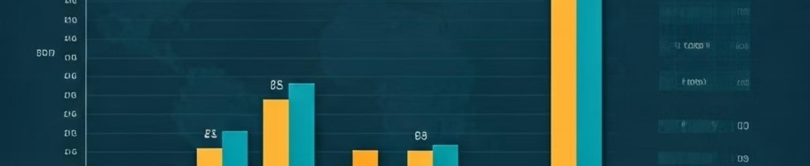
Demographic Breakdown
Age Range
18-25
26-35
36-45
Percentage
30%
40%
30%
Income Level
Middle
Upper-Middle
High
Geographic Focus
North America
Europe (France)
Asia

Slide 8
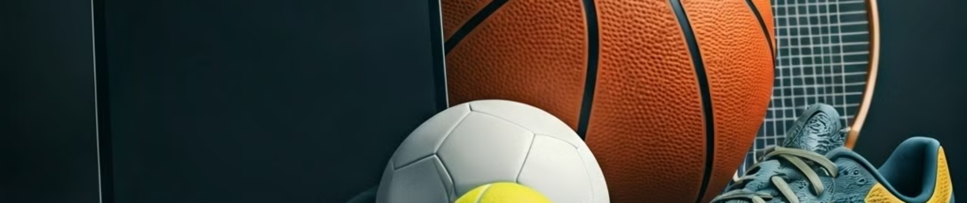



Psychographic Profile
Consumers who are early adopters of technology, particularly those interested in innovations in smartphones, wearables, and other digital devices. They are eager to stay ahead of trends and value cutting-edge technology.
Tech Enthusiasts
Adventurous and Trendsetters
Sports Enthusiasts and Athletes
Consumers who are early adopters of technology, particularly those interested in innovations in smartphones, wearables, and other digital devices. They are eager to stay ahead of trends and value cutting-edge technology.
Individuals who want to be seen as part of the "next wave" of trends. This includes people who enjoy travel, new experiences, and innovative products that enhance their lifestyles.
Fans of the Olympics and those who enjoy or participate in athletic activities. The ad could focus on those who value health, fitness, and sports culture, given the connection to a global sporting event.

Slide 9
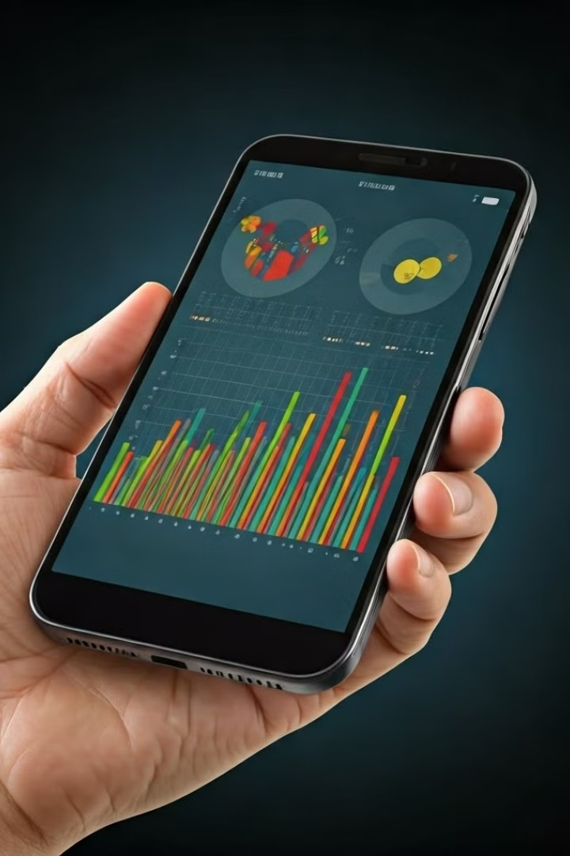



Target Segment Rationale
Market Influence
These segments are trendsetters, driving wider consumer technology adoption and preferences.
High Engagement
Active digital platform users amplify marketing messages through social sharing and interactions.
Brand Loyalty Potential
Targeting these segments fosters long-term brand loyalty and creates passionate advocates.

Slide 10
Strategic Advertisement Goals
Enhancing brand visibility and engagement
Showcasing innovation
Aligning with values of openness and inclusivity

Slide 11
Enhancing brand visibility and engagement
Global reach through strategic placement.
Interactive experiences at Olympic Rendezvous @ Samsung
High-impact advertisements in Paris

Slide 12
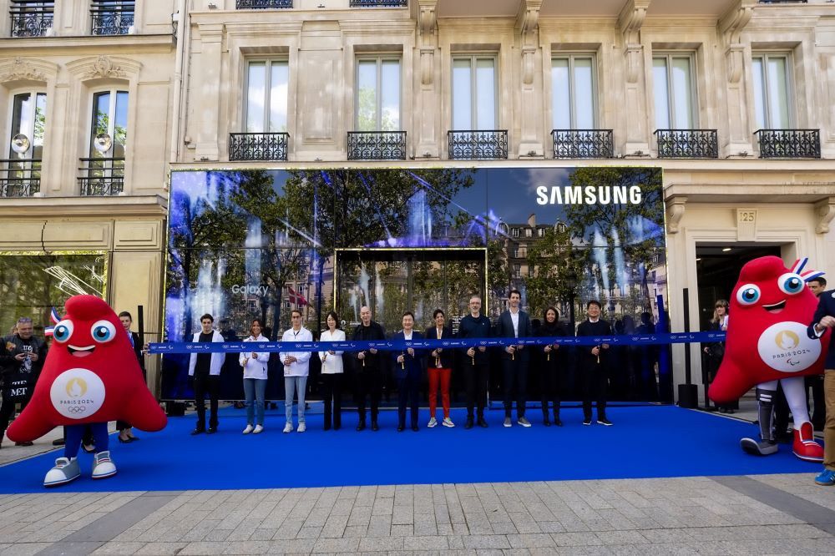
Olympic Rendezvous @ Samsung on Champs-Elysees

Slide 13
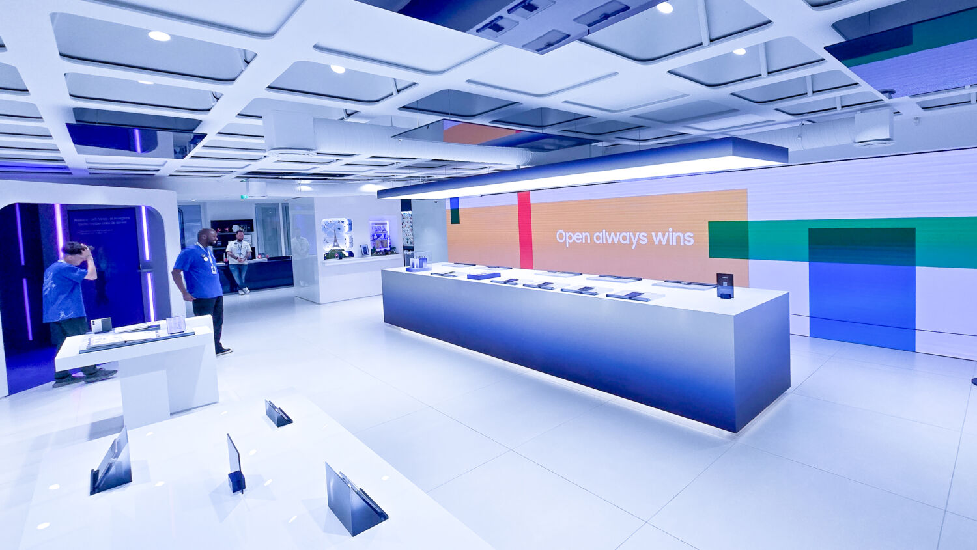

Slide 14
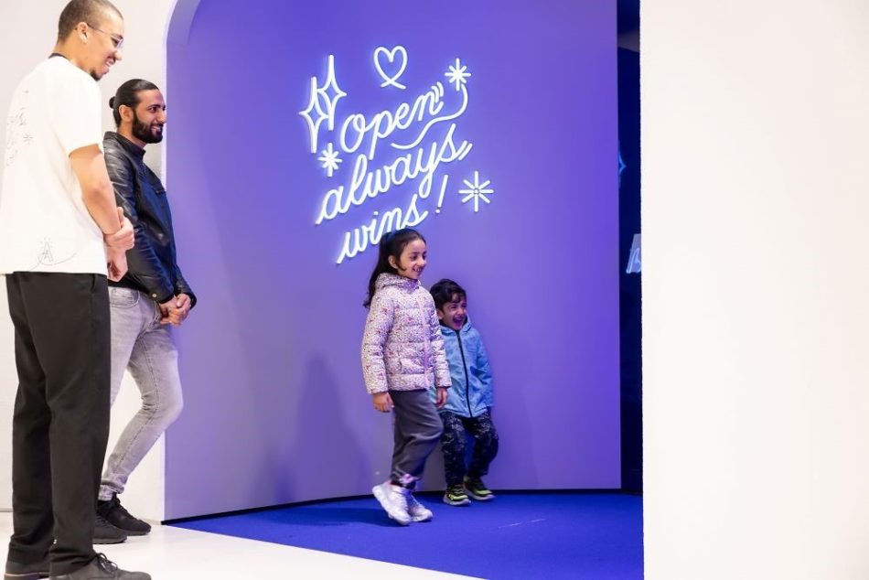
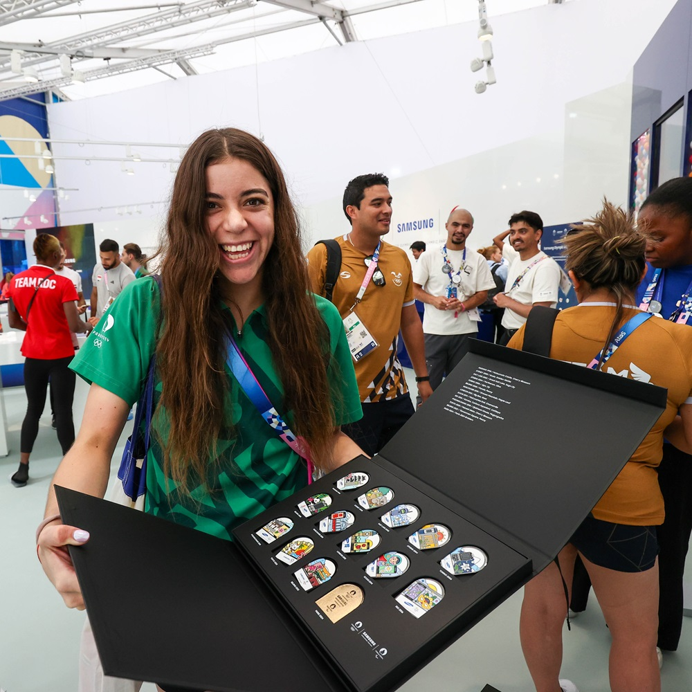

Slide 15
Showcasing Innovation
Technological Integration with 17,000 Galaxy Devices
Exclusive product launches like the Galaxy Z Flip6 Olympic Edition
Innovative campaigns like "Open Always Wins".

Slide 16
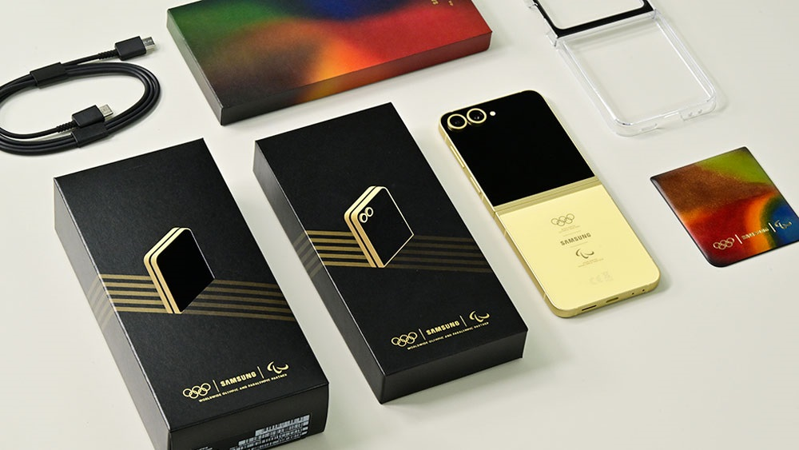
Samsung Galaxy Z Flip6 Olympic Edition

Slide 17
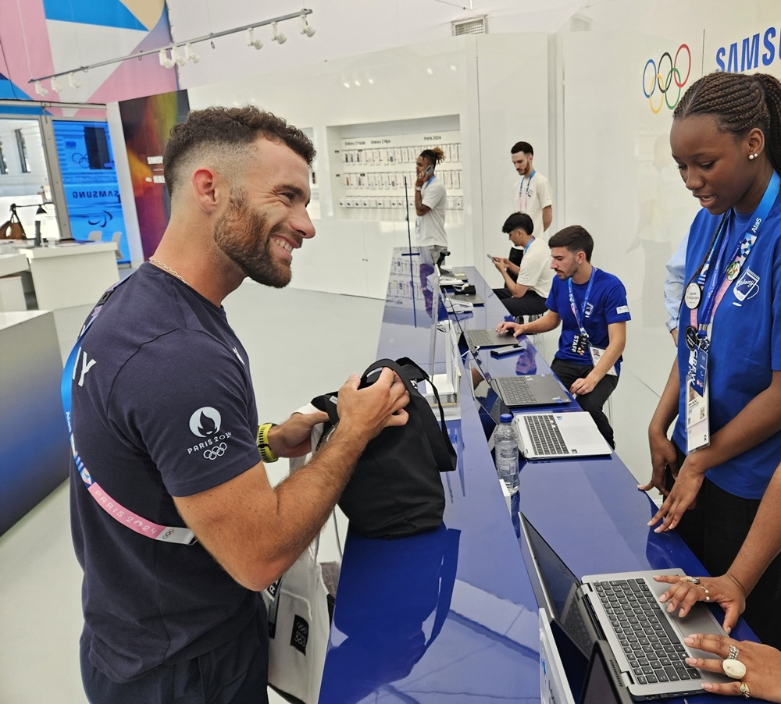
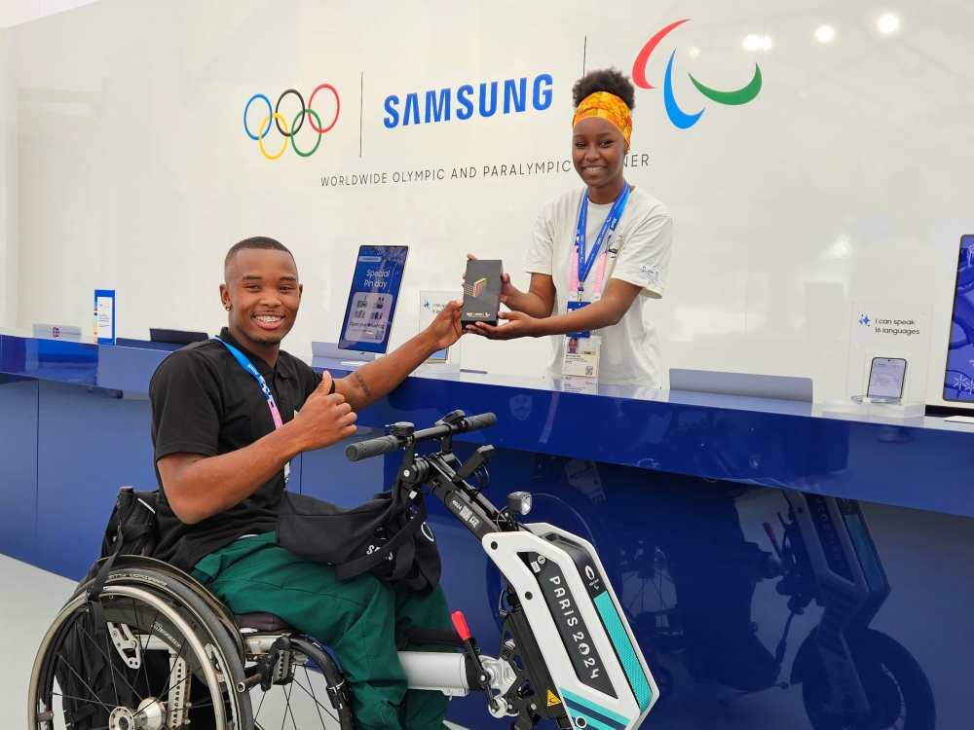
Team Uruguay rower Bruno Cetraro Berriolo – first athlete to receive the phone.

Slide 18
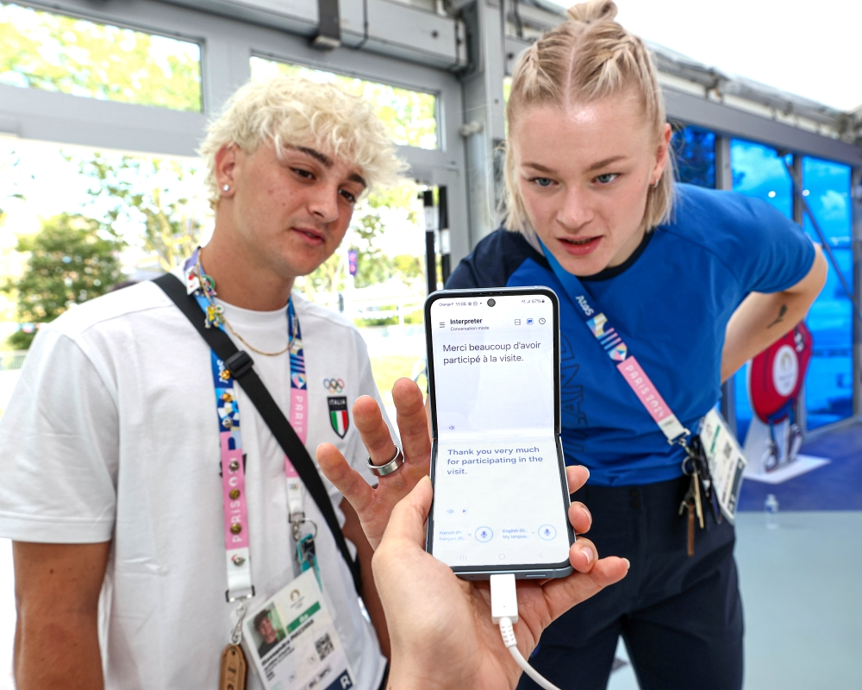
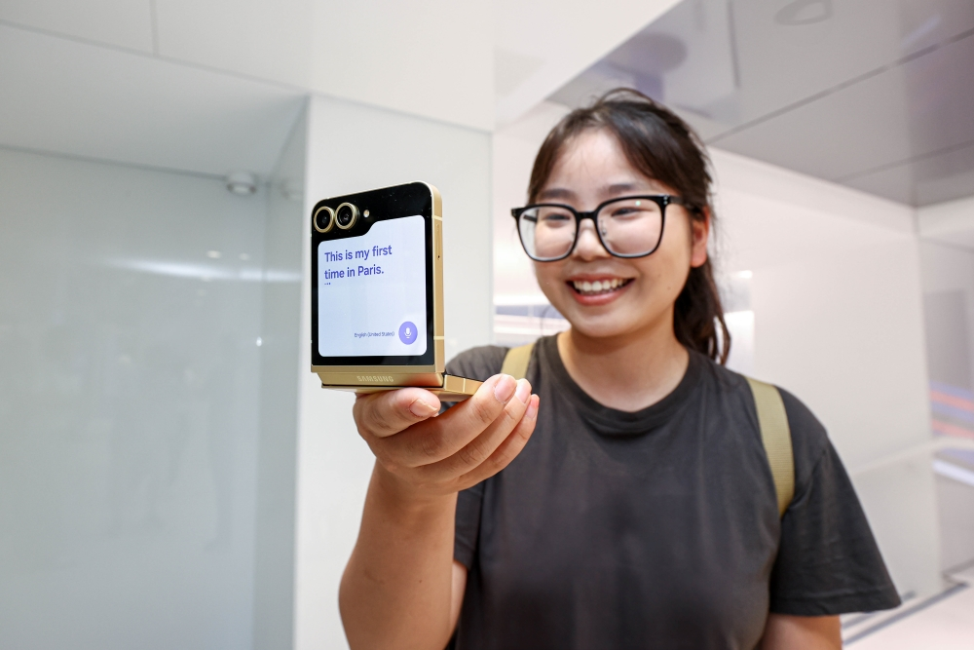
Samsung Interpreter in action at the Olympic Rendezvous

Slide 19
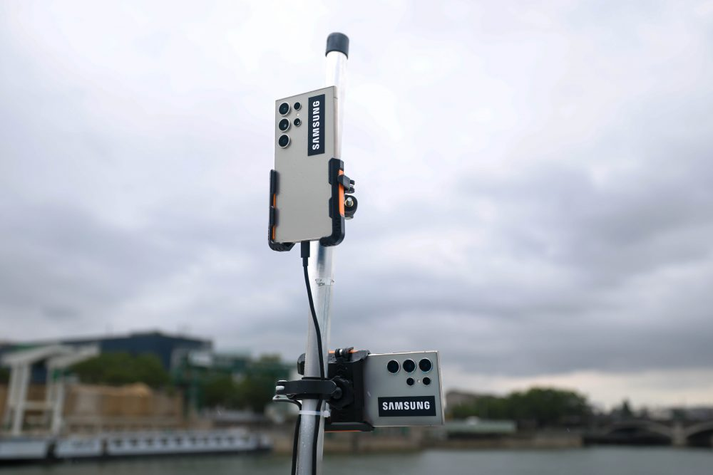
Fleet of 250+ S24 Ultra setup at prime locations to assist with broadcasting the opening ceremony.

Slide 20
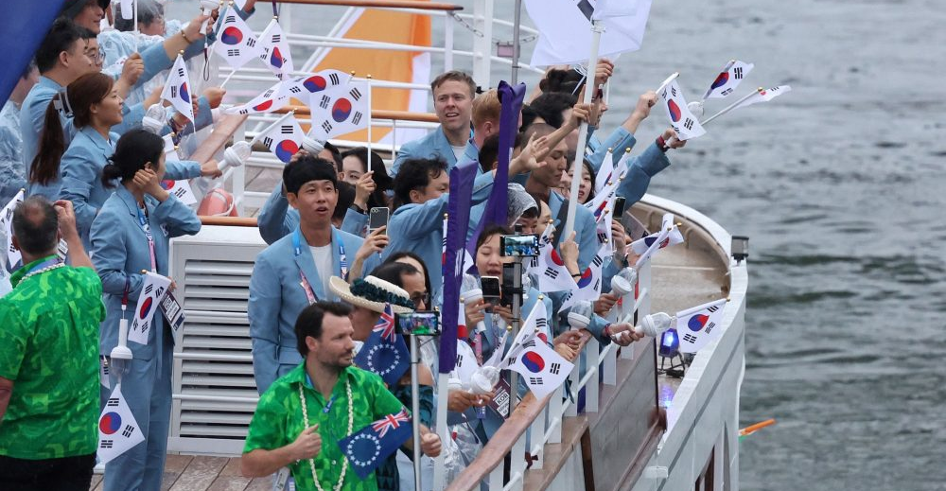
Team South Korea

Slide 21
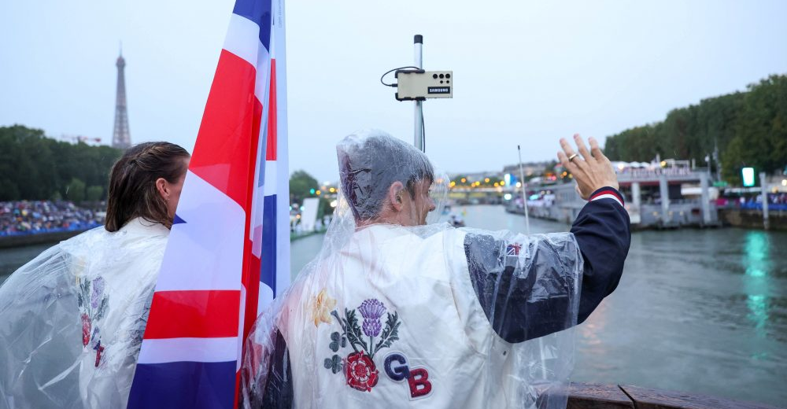
Team GB

Slide 22
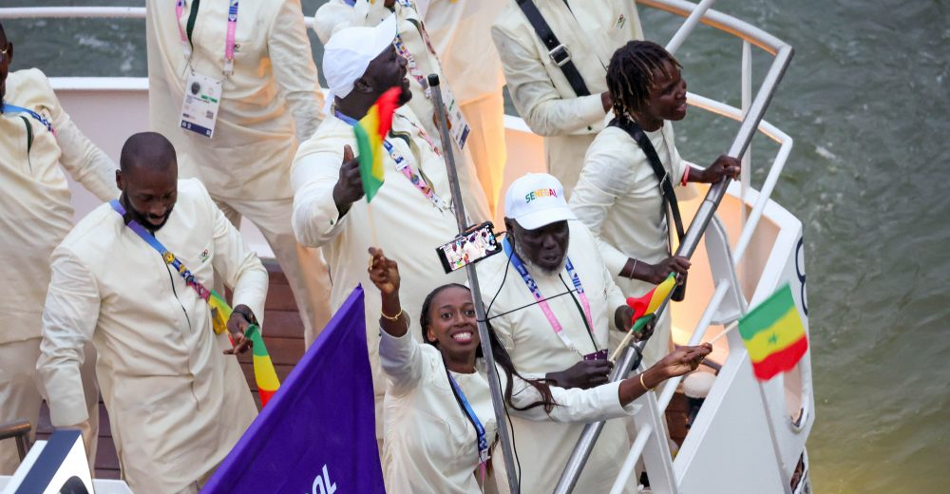
Team Senegal

Slide 23
Aligning with values of openness and inclusivity
Campaign messaging promoting openness and inclusivity
Community engagement through “Together for Tomorrow, Enabling People”
Athlete partnerships

Slide 24
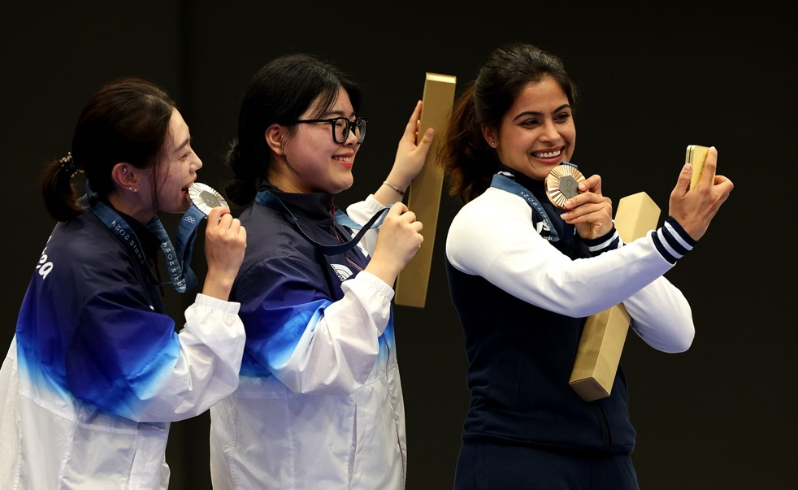

Slide 25
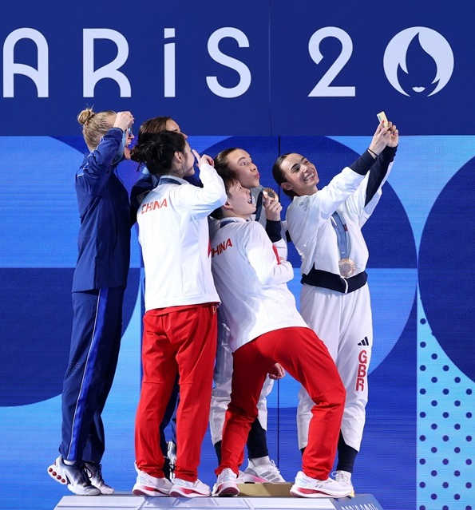
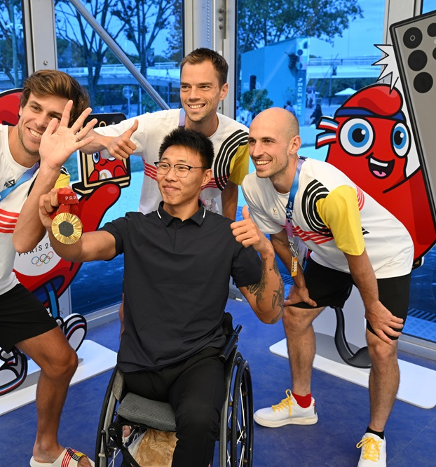

Slide 26
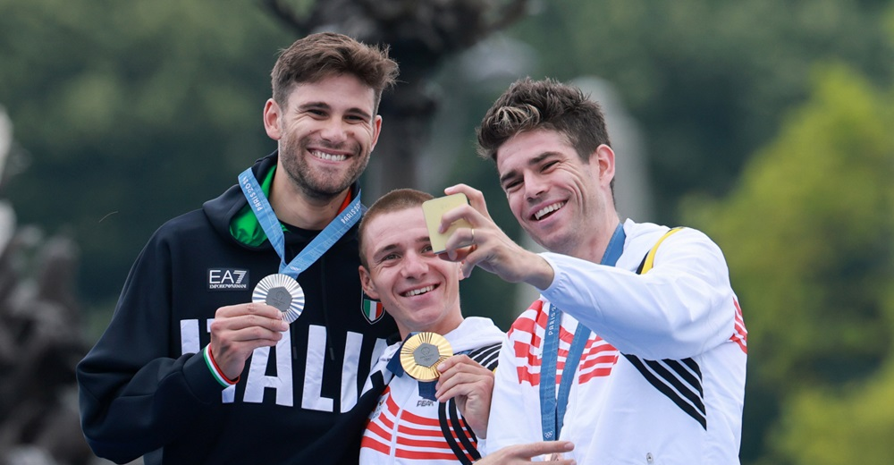

Slide 27
AUDIENCE ACCEPTANCE

Slide 28
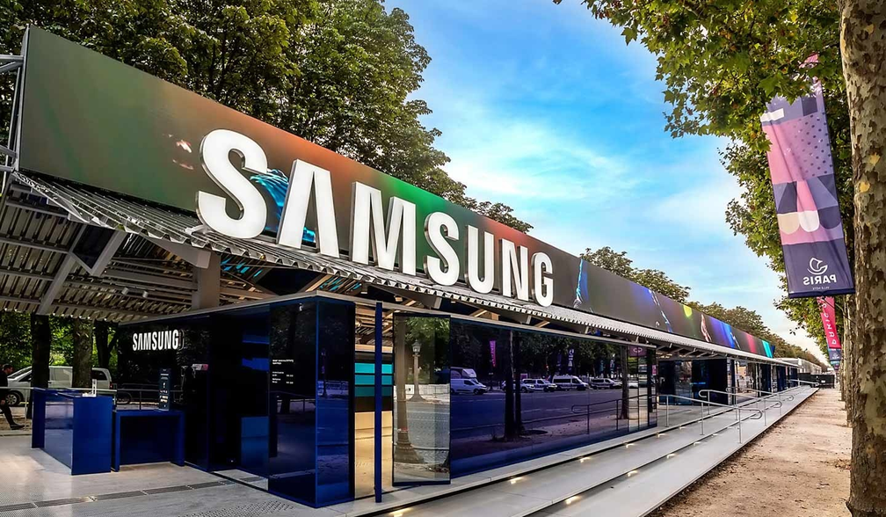
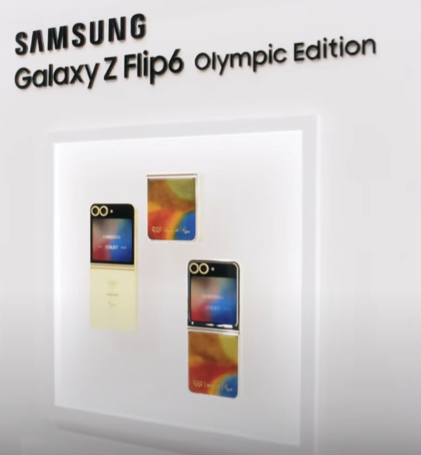
GOOD EXPOSURE
SAMSUNG X PARIS 2024: OLYMPIC GAMES EXPERIENCE
GALAXY Z FLIP6 OLYMPIC EDITION
Samsung has strategically placed banners featuring the Galaxy Z Flip 5 in popular Parisian locations

Slide 29
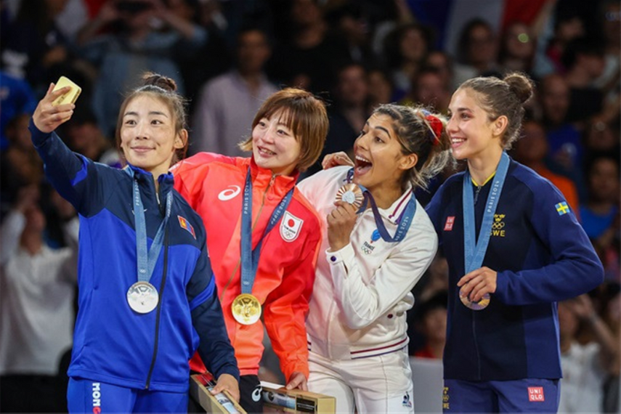
SPIKE IN SALES
+24K
VICTORY SELFIES
+23%
Samsung had a 23% spike in sales of the Flip6 on 30 July, compared to the average day at the Olympic Games. British team win six medals on the previous day, which Samsung said could have caused the spike in interest.
PHONE GIFTS
+17K
Samsung gave 17,000 of its new Galaxy Z Flip6 Olympic Edition to Olympic athletes and distribute 5000 more to Paralympic competitors.

Slide 30
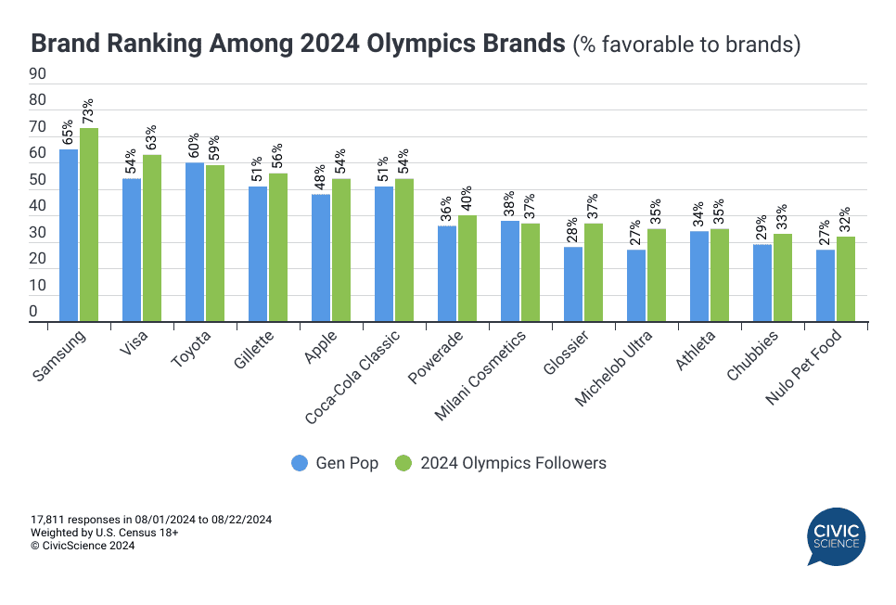
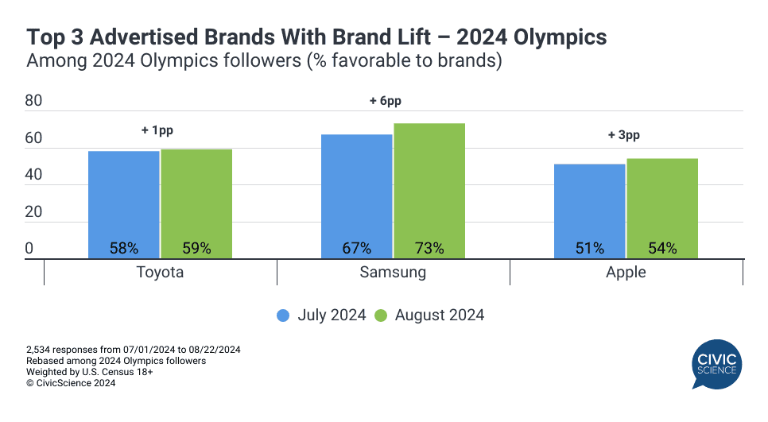
HIGH POSITIVE AUDIENCE ACCEPTENCE
65% GEN POP FAVORABLE
+6 PP FROM MONTH TO MONTH
73% OLYMPICS FOLLOWERS
Among 13 brands that had advertising campaigns and/or partnerships with leagues or individual athletes, Samsung emerged as the most favorable.

Slide 31
"SAMSUNG'S MESSAGE”"
Brand Positioning & Innovation
Connecting through Shared Experiences
Global Reach & Diversity
Message: Samsung positions itself as a tech leader.
Target Interpretation: "Open Always Wins" reinforces innovation and collaboration.
Data Insight: 62% of consumers associate event sponsors with innovation (Statista).
Message: Focus on teamwork and achievement.
Target Interpretation: "Together for Tomorrow" resonates with values of unity.
Data Insight: 64% of consumers engage with socially-driven brands (Nielsen).
Message: Emphasizing inclusivity and diversity.
Target Interpretation: Aligns with Olympic diversity, increasing brand loyalty.
Data Insight: Diversity-focused brands improve loyalty by 20% (McKinsey).

Slide 32
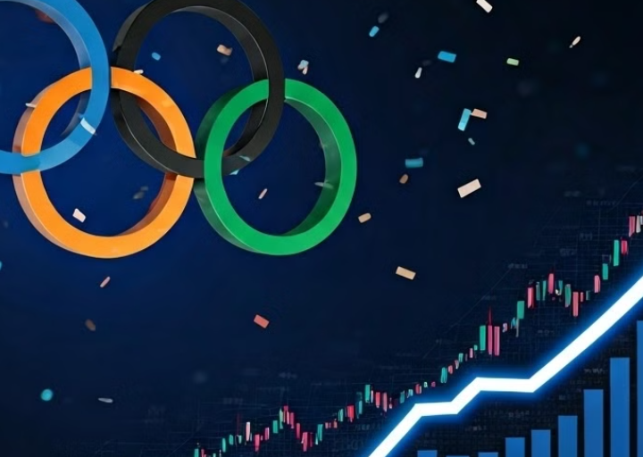
BRAND POSITIONING
Significant Sales Increase: Samsung experienced a remarkable 23% spike in sales of its Galaxy Z Flip6 on July 30, 2024, compared to average sales during the Olympic Games1.
Market Leadership: Following the Olympics, Samsung reclaimed the top spot in the worldwide smartphone market with a 20% share, bolstered by positive consumer responses to its Galaxy AI features. This performance closely contrasted with Apple, which held a 16% share during the same period and faced challenges in strategic markets.
Consumer Trends: The increase in market share was also driven by stabilizing consumer sentiment and expanding AI capabilities in its products, contributing to an overall 8% rise in shipments during Q2 2024

Slide 33
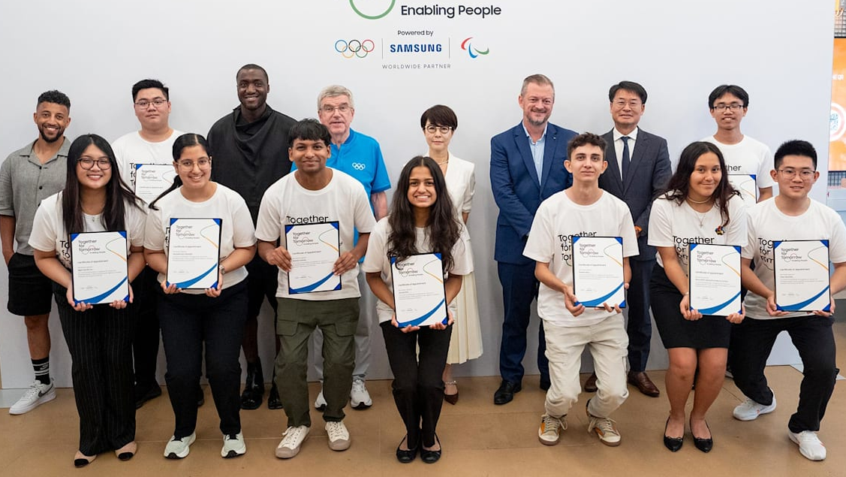
CONNECTING THROUGH SHARED EXPERIENCES
Together for Tomorrow, Enabling People

Slide 34

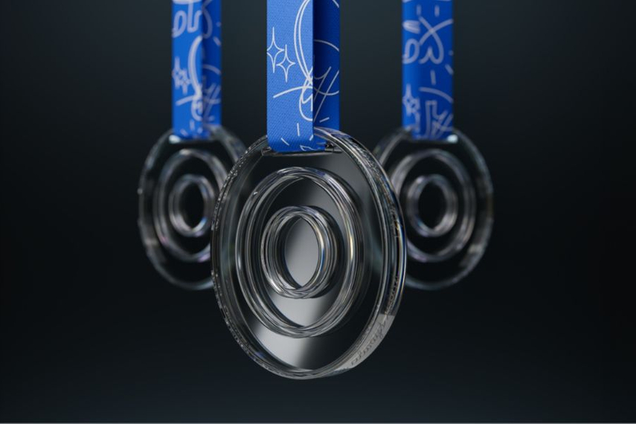
Openness Medal

Slide 35
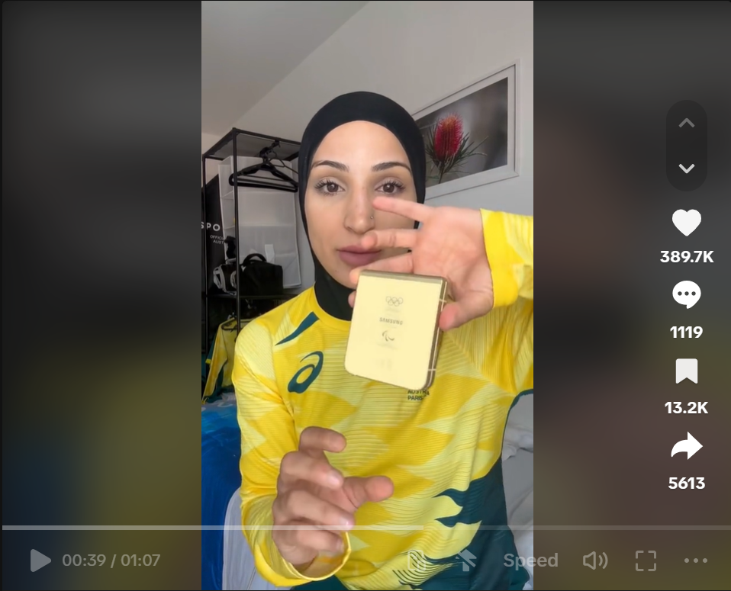
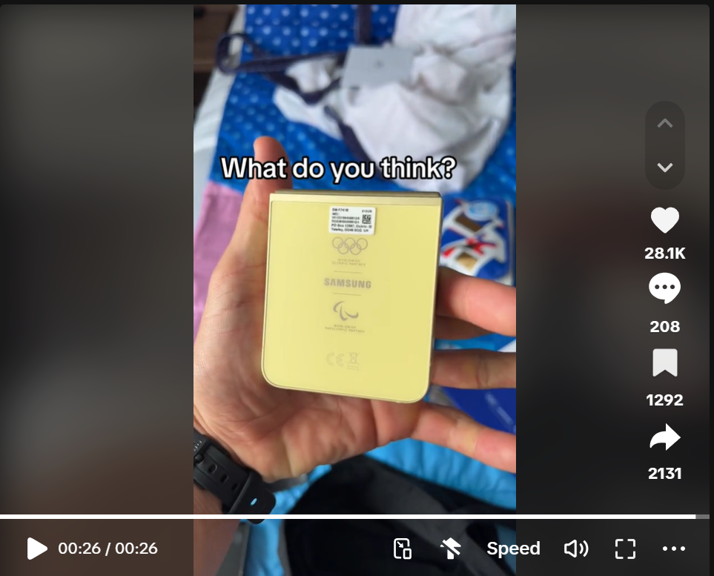
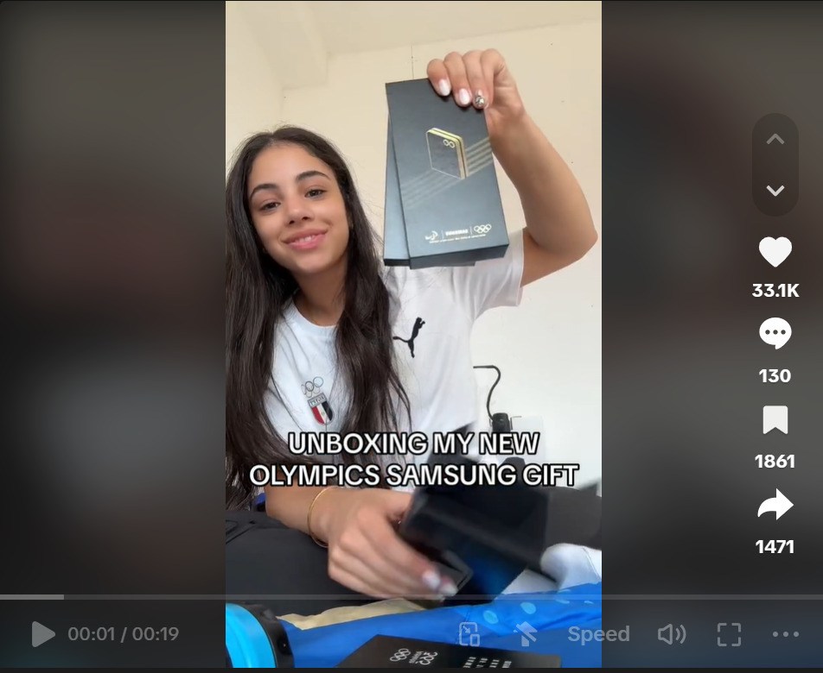
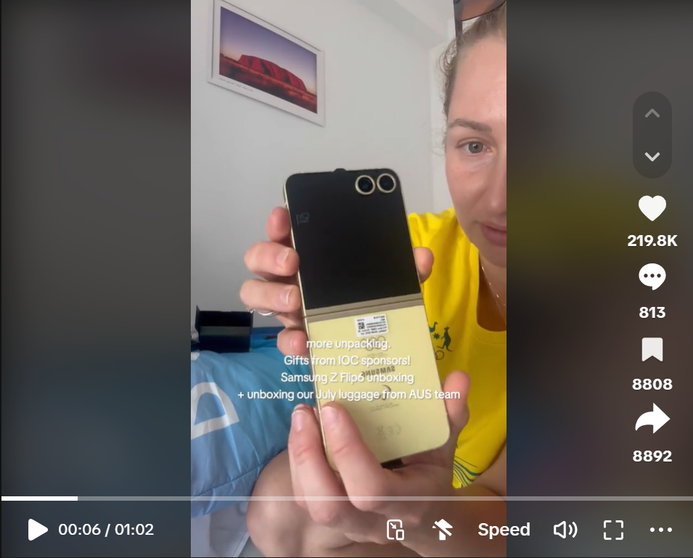
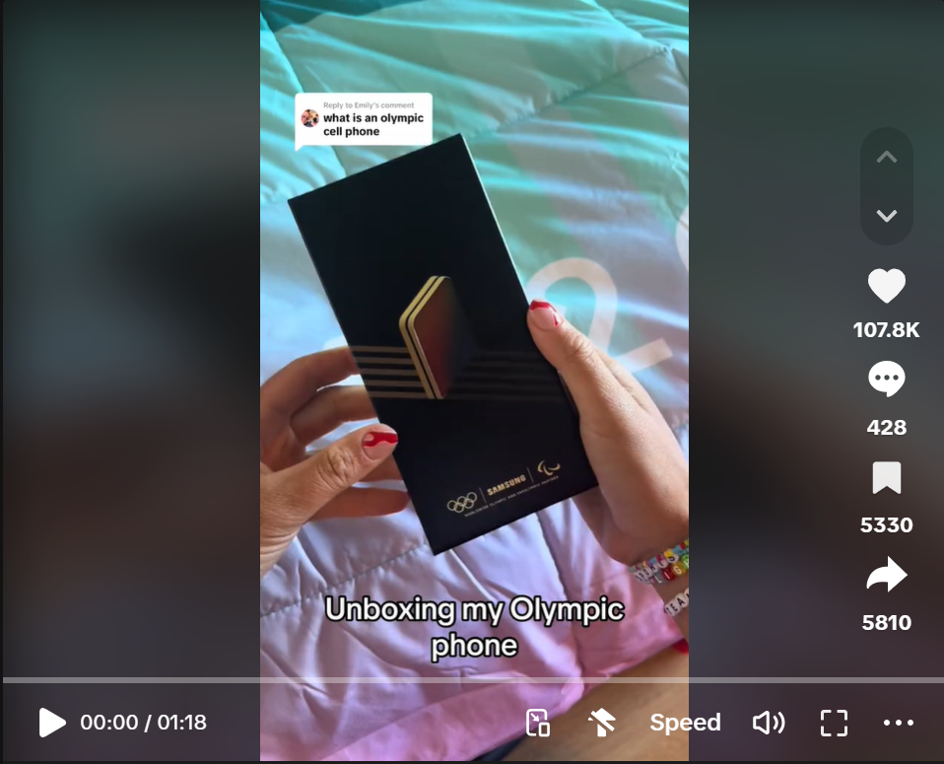
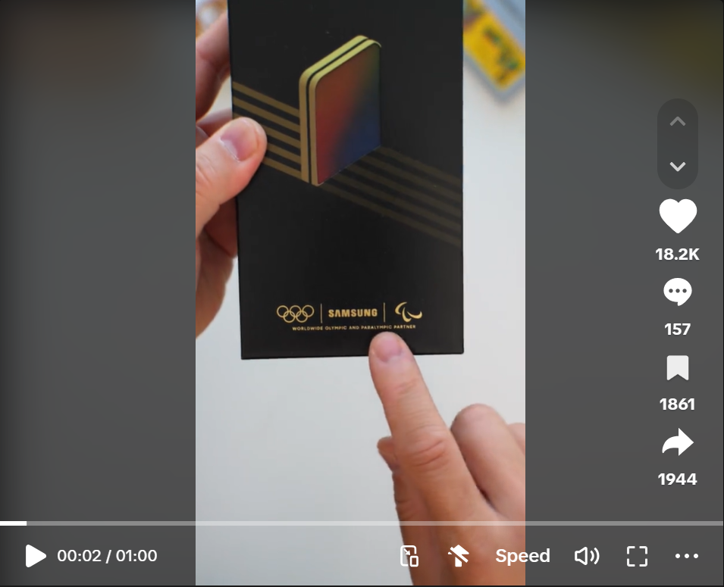
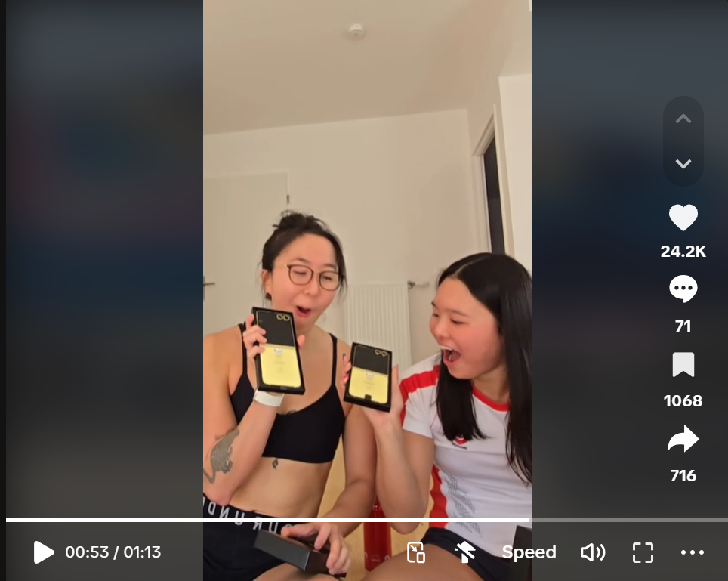
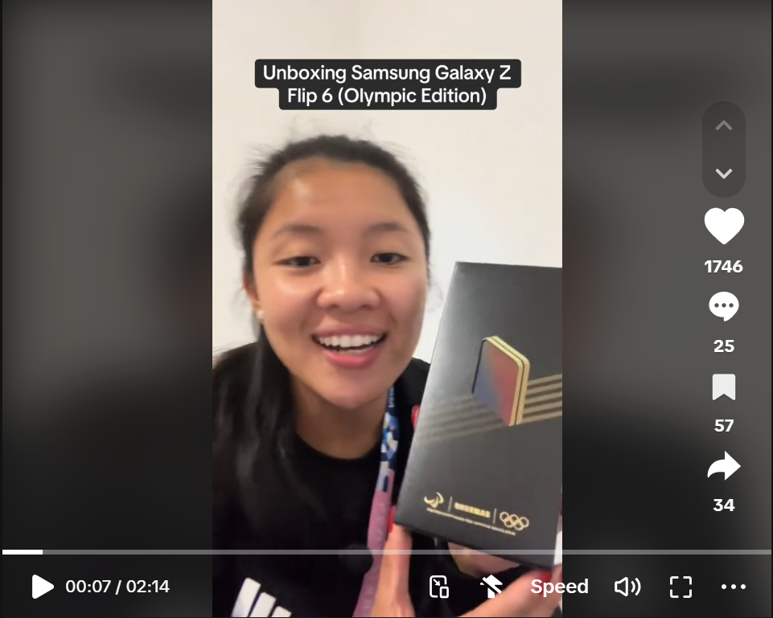
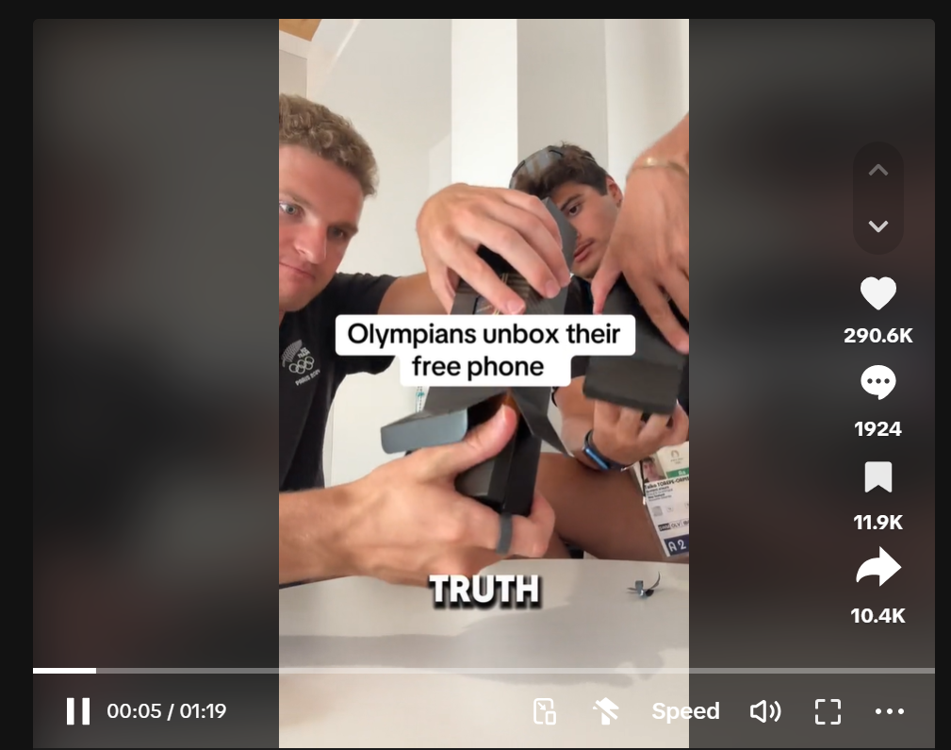
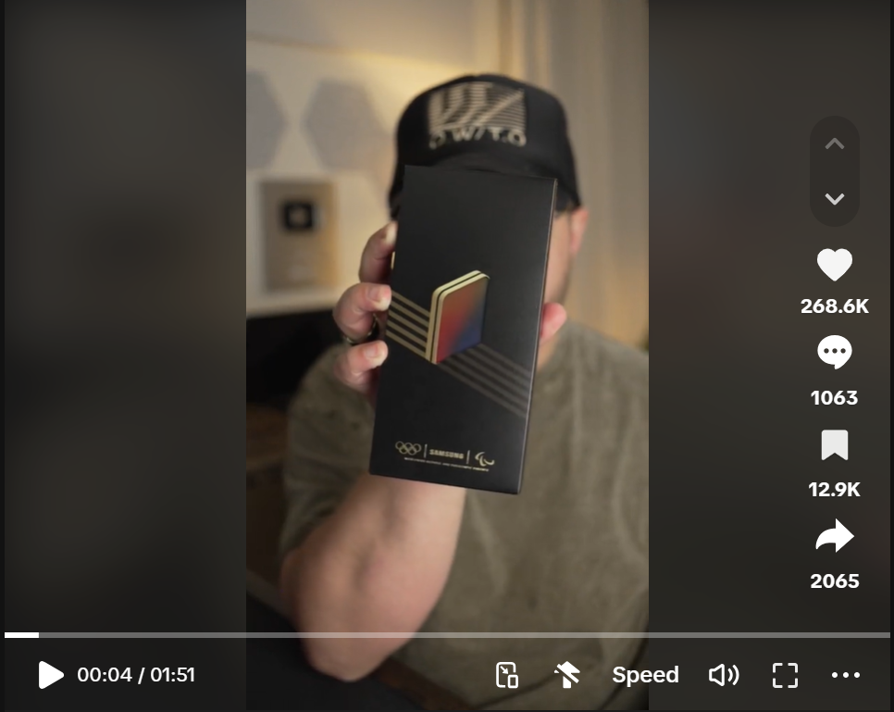
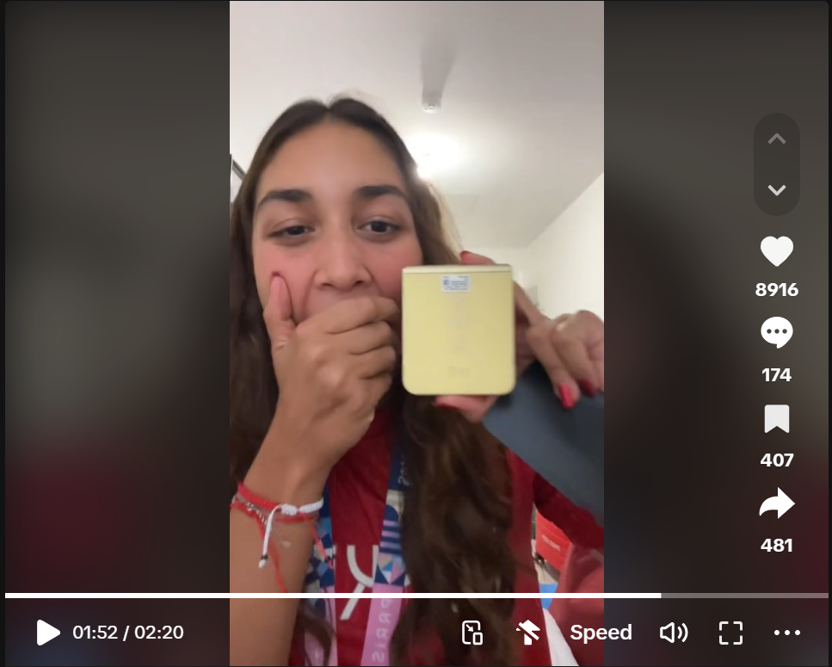
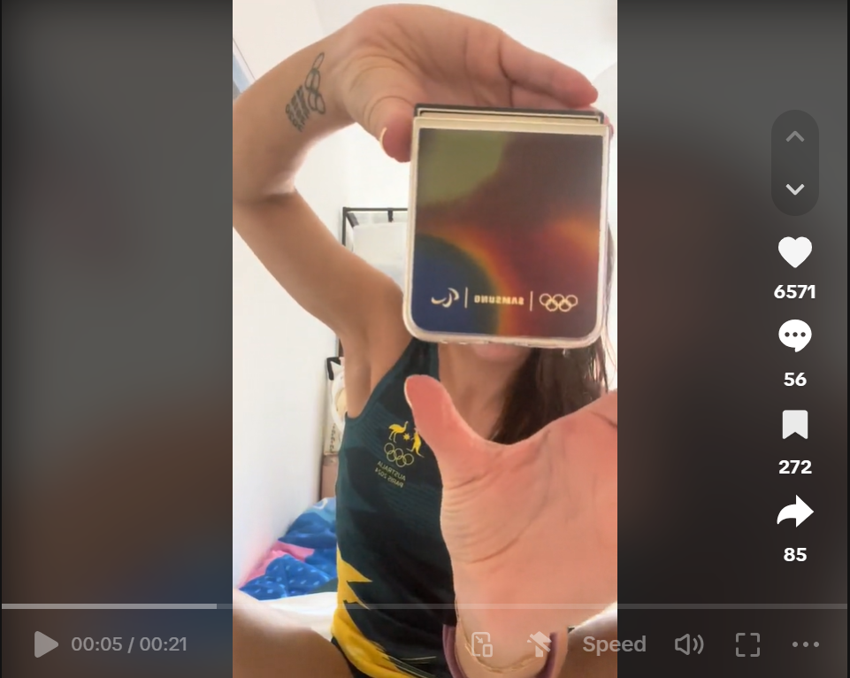
GLOBAL REACH AND DIVERSITY

Slide 36
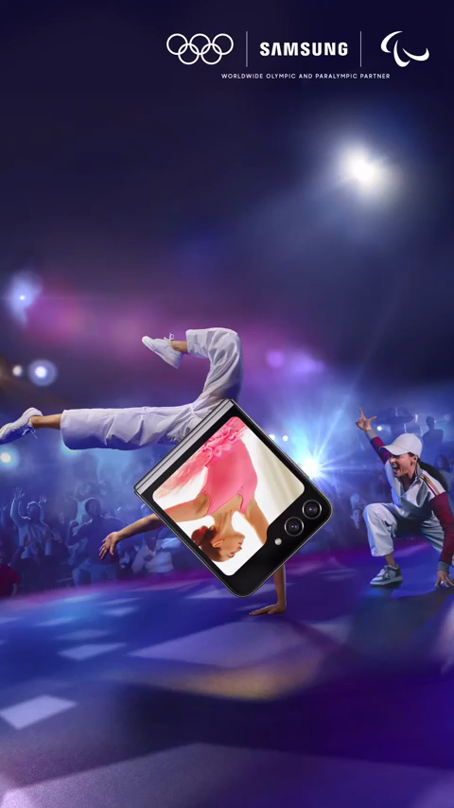
GLOBAL REACH AND DIVERSITY

Slide 37

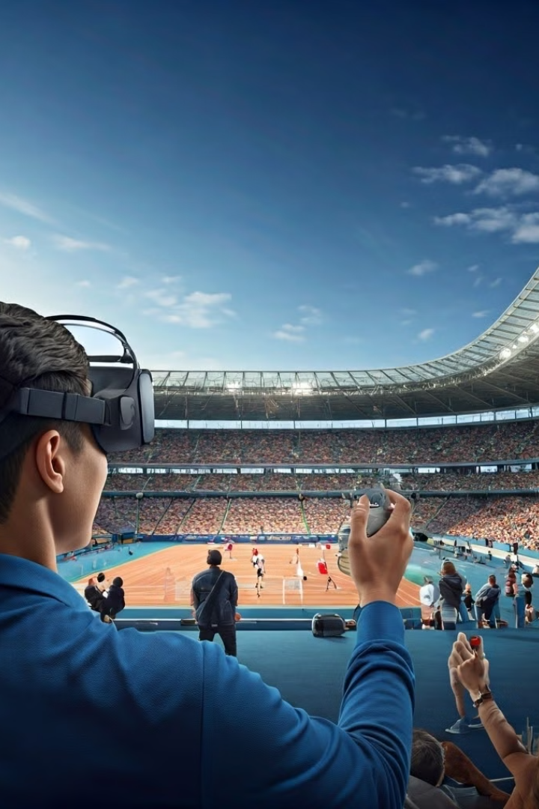
Tech-Savvy Consumers
1
Cutting-edge Technology
Samsung highlighted innovative features like the Galaxy Z Flip6 Olympic Edition and 5G connectivity. It has incorporated immersive VR experiences.
2
Enhanced Experiences
74% of consumers seek tech that enhances their event experiences.
3
Advanced Functionality
The campaign appealed to consumers prioritizing cutting-edge technology in their devices.

Slide 38
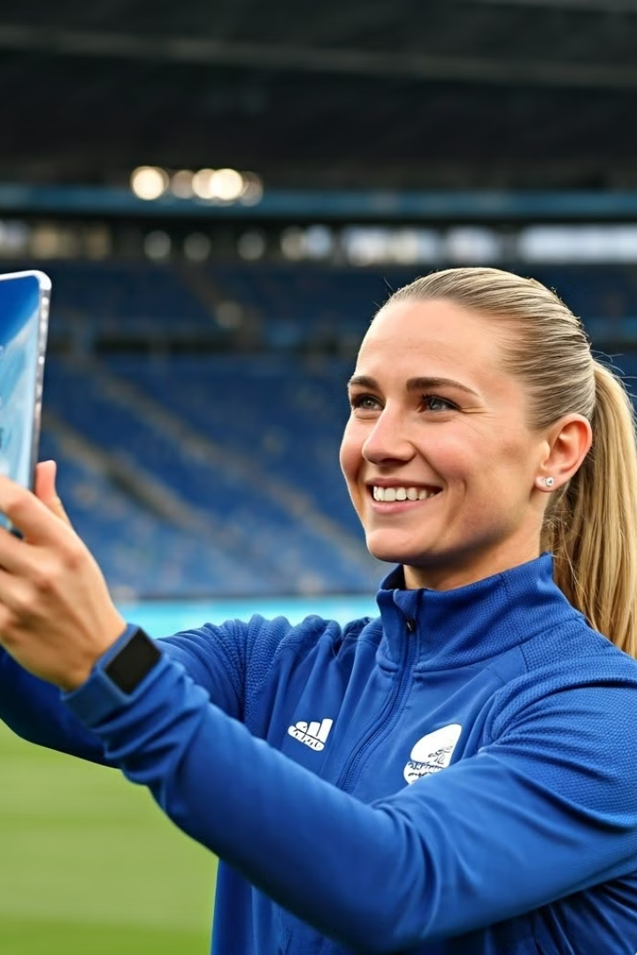
Social Media Enthusiasts
1
Authentic Content
The "Victory Selfies" initiative created user-generated content from athletes.
2
Shareable Moments
Athletes shared personal Olympic moments using Samsung phones.
3
Engagement Boost
70% of consumers are more likely to engage with interactive brands.

Slide 39
Emotionally-Driven Consumers
Social Values
Olympic Spirit
Consumer Engagement
Samsung's "Open Always Wins" message emphasized diversity and unity.
The campaign reflected values aligned with the Olympic spirit.
64% of consumers engage more with brands supporting social causes.

Slide 40




Exclusive Product Enthusiasts
Limited Edition
Samsung offered Olympic Edition devices, creating hype and exclusivity.
Anticipation
The special editions drove pre-orders and consumer excitement.
Loyalty Boost
Limited edition products are known to increase loyalty and engagement.

Slide 41

Meeting the Demands of the Target Market
Target Audience
Needs
Samsung's Response
Tech-Savvy Millennials
Innovative, immersive experiences
Incorporating VR, AR, and interactive digital content
Family-Oriented Consumers
Heartwarming, inclusive narratives
Featuring stories that resonate with families and multi-generational households
Sports Enthusiasts
Authentic, compelling connections to the Olympic brand
Aligning campaigns with Olympic values and fan passions
Global Audiences
Culturally-relevant, accessible content
Tailoring campaigns to diverse international markets and preferences

Slide 42


Communication Strategy & Underlying Persuasive Process
In a nutshell, Samsung's 2024 Olympics campaign leverages emotional appeal, celebrity endorsements, and technological innovation. The strategy aims to associate the brand with athletic excellence and global unity.

Slide 43
Emotional Appeal and Endorsements
Associative Advertising
Celebrity Endorsements
Samsung aligns with Olympic values of excellence and achievement. This creates an emotional connection with viewers.
Olympic athletes in ads provide credibility and social proof. This enhances persuasion through the endorsement effect.

Slide 44

Technological Innovation
1
Product Performance
2
High-Resolution TVs
Samsung emphasizes how its tech enhances Olympic viewing experiences.
Showcasing crisp, clear visuals of Olympic events.
3
5G-Enabled Devices
4
VR Experiences
Highlighting fast, reliable connectivity for real-time updates.
Offering immersive ways to engage with the Olympics.

Slide 45

Strengths of the Strategy
1
Emotional Engagement
Samsung connects with audiences through Olympic values like perseverance and teamwork.
2
Global Visibility & Credibility
Partnership with Olympics enhances Samsung's brand recognition and credibility worldwide.
3
Storytelling
Following athletes' journeys makes advertisements more personal and engaging.
4
Technological Appeal
Demonstrating it's cutting edge technology can build rational persuasion, whereby it can appeal to tech savvy consumers looking for practical benefits.

Slide 46

Weaknesses and Concerns
Product Underemphasis
Brand Dilution
Risk of focusing too much on Olympics, not enough on product benefits.
Samsung may not stand out among many Olympic sponsors.
Cultural Sensitivity
Ad Fatigue
Global messaging may not resonate equally across all markets.
Overexposure during Olympics could lead to viewers tuning out.

Slide 47




Key Persuasion Issues
Authenticity
Viewers may question if Samsung truly embodies Olympic values or is it just using the event as a Marketing platform.
Product Focus
Olympic spectacle shouldn't overshadow Samsung's product benefits.
Audience Reach
Strategy must effectively target both traditional and younger, fragmented audiences.

Slide 48
References
Tosan Ebisan. (2024). How brands are redefining Paris 2024 Olympic marketing. Dotdigital. https://dotdigital.com/blog/paris-2024-olympic-marketing/
Hannah Bowler. (2024). How Samsung saved Olympics media dollars by gifting 17,000 phones to athletes. The Drum. https://www.thedrum.com/news/2024/08/26/how-samsung-saved-olympics-media-dollars-gifting-17000-phones-athletes
Danielle Commisso. (2024). Top-Performing Brand Campaigns of the 2024 Olympics: Samsung Leads. CivicScience. https://civicscience.com/top-performing-brand-campaigns-of-the-2024-olympics-samsung-leads/
Makari, Reem. “Samsung Sees Spike in Sales with Olympics Sponsored Winners’selfie Moments.” Campaign, Performance Marketing World, 7 Aug. 2024, https://www.campaignasia.com/article/samsung-sees-spike-in-sales-with-olympics-sponsored-winners-selfie-moments/497568.
Samsung. “Samsung Marks Final Countdown to Paris 2024 With New OlympicTM Rendezvous @ Samsung | Square Marigny.” Samsung, 26 July 2024, https://news.samsung.com/my/samsung-marks-final-countdown-to-paris-2024-with-new-olympic-rendezvous-samsung-square-marigny.
https://www.is.com/community/blog/samsung-in-2024-the-users-innovation-and-technology/

Slide 49


Thank You

